Slide 1
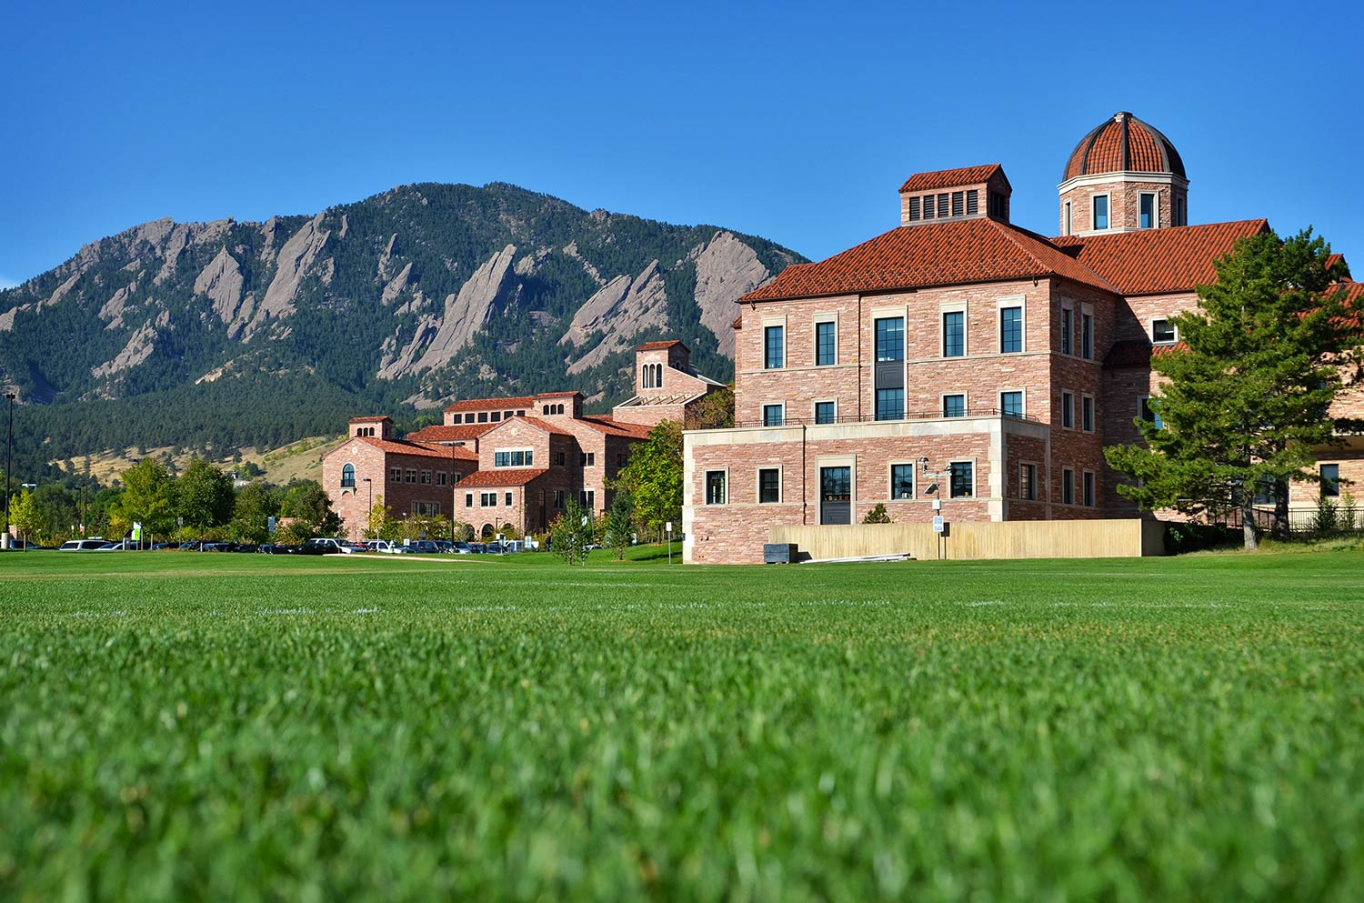
Andrew Stephan
ACCT 3220 – Corporate Financial Reporting
Jeremiah Contreras

Slide 2
Imagine
Unexpected future construction costs → Reduced revenue recognition
LIFO Liquidation disclosures show that profits should have been lower.
The “Language of Business” (technical and complex).
The lens through which business is explained and understood.
Accounting, finance, marketing, or running your own company…
The “Language of Business” will give you an edge.
Notes:
Imagine: - You are in your first board meeting after starting your first job.
- There is discussion of unexpected future construction costs
Reduced revenue recognition.
→ And LIFO Liquidation disclosures are showing that the company’s already low profits should have been lower.
Acctg is known as the “Language of Business,” and in moments like this, it can feel technical and complex.
But it’s the lens through which business is explained and understood.
- Whether you end up in acctg, fin., mktg, or starting your own company, this “Lang of Bus” will give you an edge — in business and in your own financial life.

Slide 3
Getting to Know You
Who is in the class?
Accounting majors (primary concentration)
Finance/Accounting (accounting is secondary)
Finance (no accounting)
Question for you:
Are you considering the CPA route?
BAM (Bachelor’s Accelerated Masters)?

Slide 4
CPA Licensure in Colorado
Current education requirements:
150 credit hours (~5 years)
Other pathways:
Some states allow licensure with 120 hours + 2 years of work experience
Colorado has not yet adopted this plan
Leeds options:
Master of Accounting / Master of Taxation
BAM (Bachelor’s Accelerated Master’s program)

Slide 5
Welcome Career Services

Slide 6
Textbook
Hanlon, Hodder, Nelson, Roulstone, Dragoo, Intermediate Accounting Vol 1 & 2, 4e, 2023.
CU Book Access: $259 + Tax (RedShelf)
CHECK ACCESS TO BOOK
Access through My Course Materials on Canvas

Slide 7
Office Hours
Prof. Contreras
Office Hours: TBD
On Zoom
Teaching Assistants
Ian Ross, Anna Butler, Krish Naik & Ariel Chen
Various Office Hours (Wed – Sat → More around exams)

Slide 8
PlayPosit Videos (10%) & Homework (25%)
PlayPosits (20): Answer PlayPosit questions for each video, due 11:59 pm the day before each lecture: 10%
PlayPosit: Two attempts per question – DURING THE ATTEMPT
Late PlayPosits -20% Per Day (0.8% per hour)
DROP: Two Lowest PlayPosits
Homework (11) completed through MyBusinessCourse, generally due Saturdays – 25%
Three tries, answers carry over, with wrong answers marked
Journal Entries: Record Debits before Credits
Rounding – pay attention to question!
NO LATE HOMEWORK!! (It will auto-submit any work completed on the due date)
DROP: ONE Lowest HW Assignment
First HW is due this Saturday: The only HW through LinkedIn Learning: Any passing grade (certificate received) = 100% on the assignment!

Slide 9
Exams (65%)
There will be three (3) Midterm exams and one final exam (4 exams total). Exams will be held in class.
If you are sick, or if you miss an exam for an excused reason, you will have an opportunity to make up the exam the Saturday following the exam.
Midterm Exam 1 – 15%, Sep 24th (In-Class)
Midterm Exam 2 – 15%, Oct 22nd (In-Class)
Midterm Exam 3 – 15%, Nov. 10th (In-Class)
Final Exam – 20%, as scheduled [Dec 8 – Dec 12] (In-Class)
* Review Class before Exams 1 & 2, (No review for Exam 3: Only 2 topics) and two review days for final exam!

Slide 10
Grading Policies
Exam replacement policy
Final exam grade replaces any midterm grade if the final is higher.
What does this mean?
If you are sick and cannot make up the exam, you will receive a zero, however the final exam will replace this grade.
If you have a bad exam day and receive a low score, the final exam will replace any lower exam grade (E.G., Exam 1 = 50%, Final Exam = 80%, Exam 1 will count as 80%)
For most issues/conflicts, I rely on the exam makeup or replacement policy.
For conflicts with midterms, let me know ASAP.

Slide 11
Weekly Expectations
Two pre-recorded videos with PlayPosit questions (due the night before class at 11:59pm)
Two live classes (with in-class problems)
One homework due Saturdays at 11:59pm (TA help on Fridays and Saturdays)

Slide 12

Why Corp 1?
Why should I care?
Foundation of accounting jobs
Foundation of Finance
Foundation of Business, in general
Truly: The language of business!

Slide 13
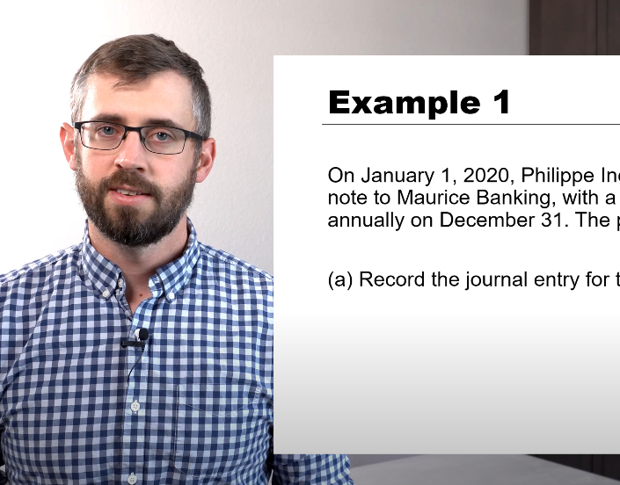
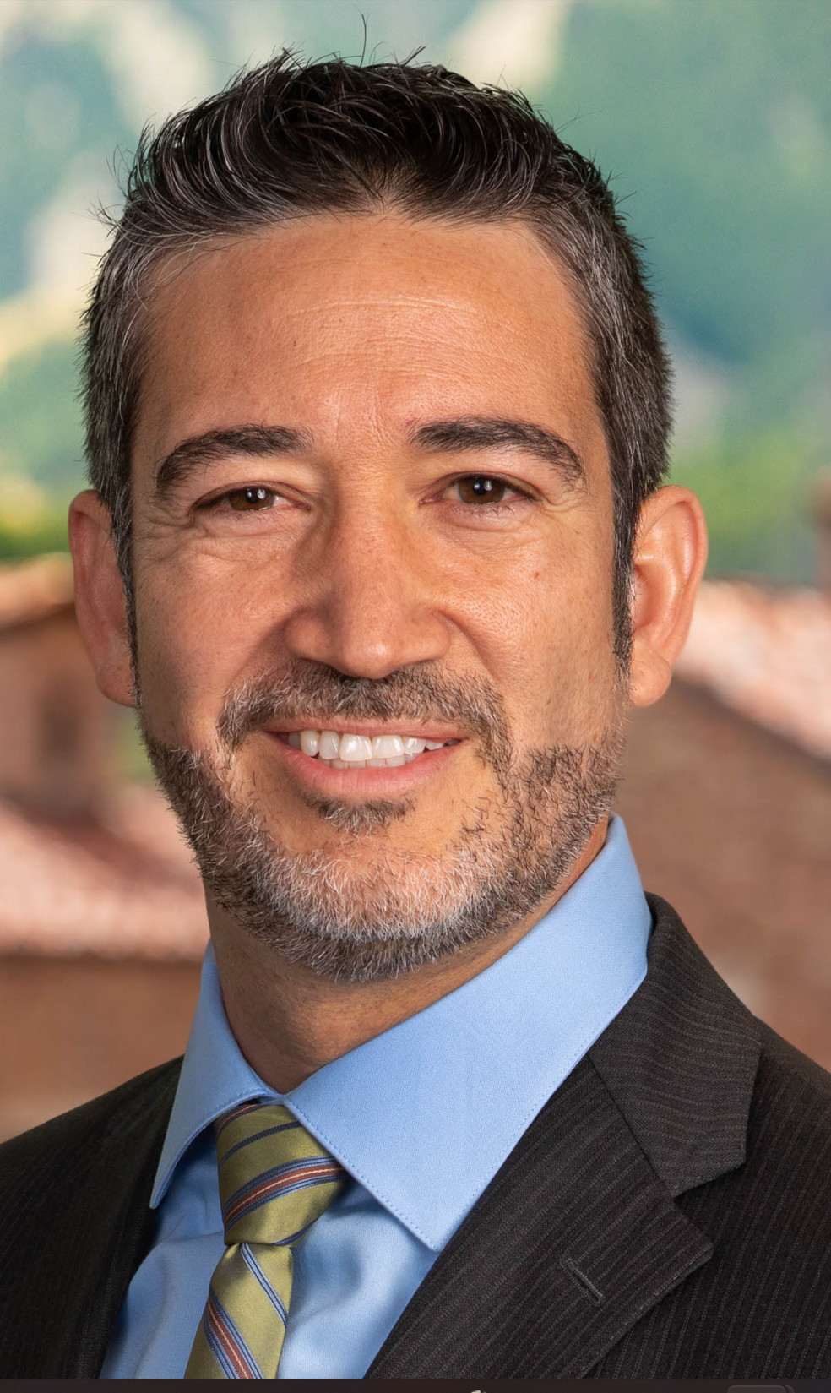
How to Succeed Before Class
Professor Stephan
Before Class
Watch videos: learn content
Note your questions about anything confusing
Answer PlayPosit questions (two attempts per question)

Slide 14

How to Succeed During Class
Be active, be brave — work the in-class problems.
Ask questions.
Commit to an answer!
Answer with pride:
What is 2 x 3 = ?
Magical Doorway

Slide 15

Exam Study Tips
Keep up with material – there are many topics!
Memorizing journal entries is like chasing your tail. Understand the concepts, and the entries will follow.
The Golden Ratio: 75% understanding, 25% memorizing/formulas/arbitrary things
Work problems first, then check solutions.
Exam studying priorities:
In-Class Problems
Bonus Problems
Homework Problems

Slide 16

Let’s walk through Canvas

Slide 17
What is our focus?

Slide 18
Financial Reporting Process
Entrepreneur
(idea)
Owners
(Equity)
Creditors
(Debt)
$$$ (Financing)
The Firm
External Parties
Infrastructure
Financial Statements
Owners
$$$
(Investing)
Investments in land, trucks, technology, etc.
Creditors
Accounting Process
Regulators
Day-to-day
Activists
Other information
Purchasing, production, marketing, etc.
Employees
$$$
(Operations)
Competitors
Customers & Suppliers
Notes:
How do we take all of these economic activities and report them in 4 pages of F/S and a bunch of footnotes? F/S is the goal.
Start with the entrepreneur:
-needs to finance an idea (sell equity and borrow)
-invest to obtain production ability and build infrastructure (buildings, machinery, inventory, patents, etc.)
-operate (day-to-day operations to generate earnings)
Accounting process accumulates and aggregates information on these activities
-create financial statements and other info
-for a variety of users
-managers will not be satisfied by this course (they have access to more detailed info)
-this course is all about information provided to EXTERNAL users

Slide 19
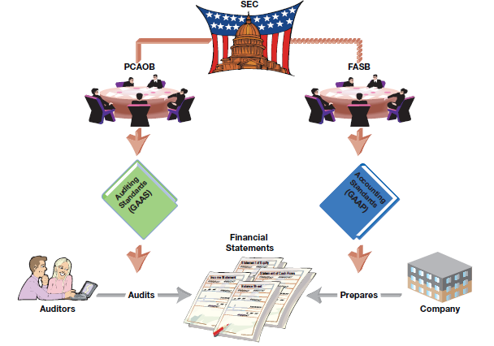
Public Company Financial Reporting
Notes:
SEC=legal authority to set accounting and auditing standards (founded as result of great depression mid-1930’s)
-delegate acct standards to FASB (created 1973)
*mgmt/firm=responsible for financials
*7 member board (former auditors, former CPAs at firms, 1 acct prof)
-delegate audit standards to PCAOB
*auditors=responsible for checking if mgmt/firm follow rules
-everyone else uses the financials
-investors, customers, suppliers, creditors (may have private), employees

Slide 20
Managing Expectations
We will be learning RULES
Sometimes, very detailed
(and yes, occasionally painful)
rules
Our ultimate goal is to understand financial statements so we can apply them to real decisions.
Notes:
Where possible, will bring in:
Edge cases/gray areas
Managerial discretion/incentives (legal and illegal!)
Must understand the basics first

Slide 21
Accounting Assumptions
Assumptions | Description
Entity | A business is treated as distinct from its owners or other businesses.
Going Concern | Assumes the entity will continue operations into the foreseeable future.
Monetary Unit | Only records transactions that can be measured in a stable currency.
Time Period | Financial activity is divided into regular time periods for reporting.

Slide 22
Accounting Principles
Principle | Description
Historical Cost | Assets and liabilities are recorded at original cost unless revaluation is allowed.
Revenue Recognition | Revenue is recognized when earned and realizable, not necessarily when cash is received.
Matching | Expenses are recognized in the same period as the revenues they help generate.
Full Disclosure | All information that affects users’ understanding must be disclosed.

Slide 23
Accounting Constraints
Constraint | Description
Materiality | Only items significant enough to influence decisions need to be recorded.
Conservatism | Choose the option that is least likely to overstate assets/income.
Cost-Benefit | The benefit of the information should outweigh the cost to produce it.
Industry Practice | Allows deviations from generic principles to reflect industry norms.

Slide 24
AI in Learning and Accounting
In what ways do people use AI in school?
What are some effective ways to use AI to learn?
How do you think the profession (accounting/finance) will expect you to approach AI?
Takeaway - AI as a tool
✅ AI can coach you through concepts and give feedback
⚠️ It shouldn’t replace your thinking or professional judgment
⚠️ It can make errors or teach topics differently from the book
Example: Google Gemini

Slide 25
Recap
Watch PlayPosit videos (answer questions) before class (first PlayPosit due before the next class!)
Come prepared to work through in-class problems
First homework due THIS Saturday, Aug. 30 (LinkedIn Learning)

Slide 26
Andrew Stephan
ACCT 3220
Introduction to Financial Reporting
Notes:
Today:
START with Professional Mentorship Program
Welcome
Who is here? (acct/fin, jr/sr)
Goal for the class is to understand how economic transactions are accounted for in the F/S
Important (tools for classes/life and interesting)
Plan to invest in public cos?
Plan to work for public co?
Interact w/public co (supplier, customer, lender, etc)
Take more acct or fin classes? Recommend CORP 2
Administrative
Overview
Ch 1-2 (mechanics and start into financial statements)
To bring
-syllabus, calendar, name cards to handout
-textbook + lemonade stand
-pull up D2L
-memory stick, clicker, pen

